Slide 1


Green Pace
CS 405
18 April 2024
Security Policy Presentation
Developer: Andre Burton

Slide 2

OVERVIEW: DEFENSE IN DEPTH
Defense in Depth is the software development security strategy that builds many layers of security.
Individual items may not cover all security vulnerabilities but combined provide thorough protection.
Proper implementation is necessary for today's vulnerabilities and breaches.

Slide 3
10 PRINCIPLES
These are the 10 coding standards
In each standard there are the coding standards used in the last examples
Each example was put under a coding standard to show how the principle with effected use could prevent the coding issues
This list is simple, and some coding standards could fall into multiple coding Principles
1 - Validate Input Date
+ INT-35-C
+ DCL-50-CPP
2 - Heed Compiler Warnings
+ ERR-51-CPP
3 - Architect and Design for Security Policies
+ FIO-46-C
4 - Keep It Simple
5 - Default Deny
6 - Adhere to the principle of Least Privilege
7 - Sanitize Data Sent to Other Systems
+ EXP-63-CPP
8 - Practice Defense In Depth
+ DCL-03-C
9 - Use Effective Quality Assurance Techniques
+ STR-51-CPP
+ MEM-34-C
+ CTR-57-CPP
10 - Adopt a Secure Coding Standard
+ IDS-00-J

Slide 4
THREATS MATRIX
The table shows an overview of the severity of threats
All threats should be fixed but using the chart should help teams choice which ones must come first.
Automation can and should be used to catch these coding vulnerabilities
Threat Matrix Table | High Severity | Medium Severity | Low Severity
Likely | IDS-00-J MEM-34-C STR-51-CPP
Probable | DCL-50-CPP | EXP-63-CPP | ERR-51-CPP CTR-57-CPP
Unlikely |  | FIO-46-CPP | DCC-03-C INT-35-C

Slide 5
CODING STANDARDS
Coding Standard Vulnerability Ranking
1. IDS-00-J
1. MEM-34-C
1. STR-51-CPP
4. DCL-50-CPP
5. EXP-63-CPP
6. FIO-46-CPP
7. ERR-51-CPP
7. CTR-57-CPP
10. DCC-03-C
10. INT-35-C
Its important to review the previous charts and then know which coding standards should be fixed first and is highest priority.
We can see some have similar number which shows they are equally important as they fall into similar categories.
The company should find current attacker motives when deciding which vulnerability to fix first
Most
Least

Slide 6
ENCRYPTION POLICIES
Encryption In Flight - Affects information that is being sent between two point; should use 128-bit AES key for encryption from the location and then the same key for decryption at the end location; Important to use VNP’s; Prevents the information from being copied/captures/ and intercepted
Encryption at Rest - Affects physical devices such as hard drives, usb, etc.; Uses encryption keys to decrypt and encrypt information; Four encryption types fall into this which include Application Level, Database encryption, File System, And full disk.
Encryption in Use – Affects information that is actively being used or processed; Most vulnerable Encryption type out of the three; Two main types fall into this which includes partially homomorphic and fully homomorphic; There are a few complications that may arise to using one over the other and should be picked based on the project and its goals

Slide 7
TRIPLE-A POLICIES
Authentication - Tasked with identifying users; Identifying the user includes use of proper credentials and verify through a database; there are three main authentication types used which include secret information(usernames, passwords), Physical items(id Cards), and personal physical identification(eye/fingerprint scans).
Authorization - Tasked with assigning level of access to authorized users; Default Deny should be used; Level of access is stored in the database and is given with an admin account;
Accounting – Tasked with measuring the usage of system resources, track login/logout times, data sent/received, IP addresses, URL tracking, and much more; Account permissions/usage audits are also done to ensure only proper access and usage occurs.

Slide 8
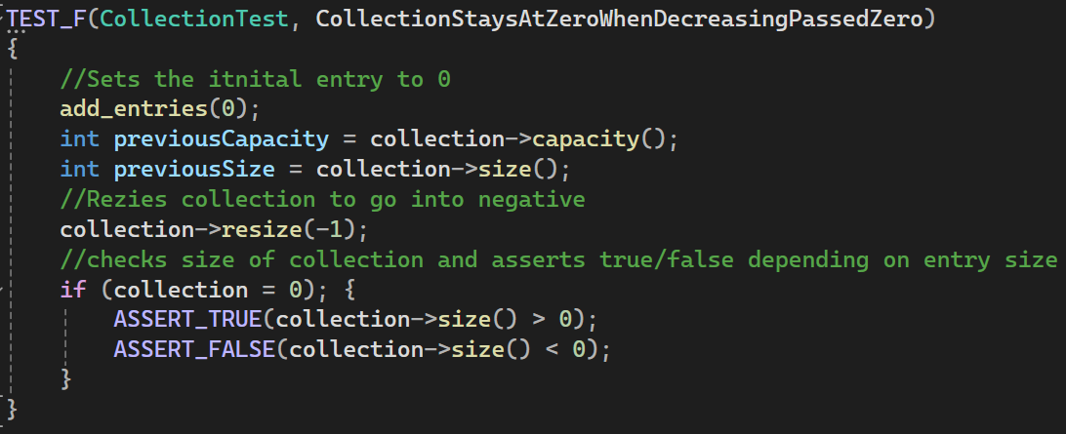
Unit Testing #1
-In this test the program was supposed to test for the collection to stay at 0 if a negative number was called
-We can see from the result the test failed
-This is an example of how the system would process a test and output the information to the developers

Slide 9
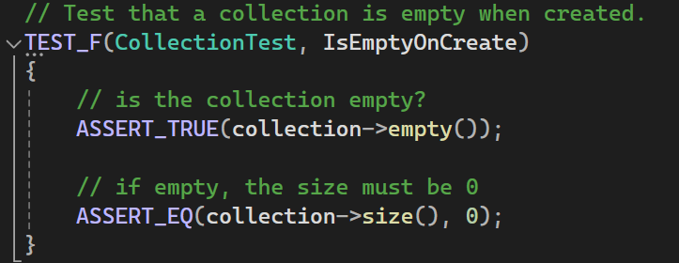
Unit Testing #2
-In this test the program checks to see the collection is empty when created
-Then the test is run and shows it is run and that the program worked and programmed
-This will help programmers check to make sure list of item start empty for users which reduces chance for errors and confusion

Slide 10
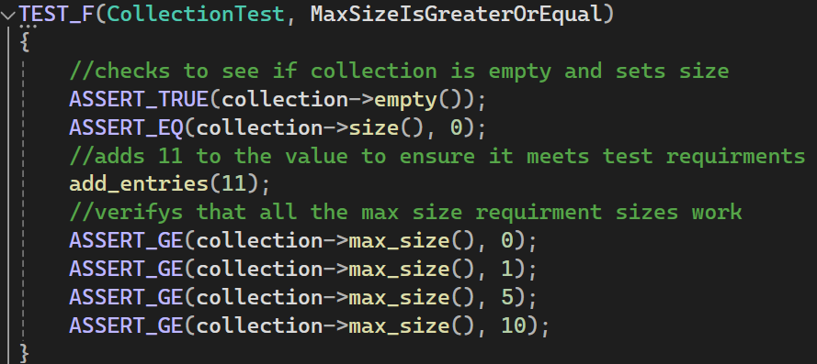
Unit Testing #3
This test checks for the size is greater or equal to the initial size
This is a good test different numbers which software programmers may use in their software.

Slide 11
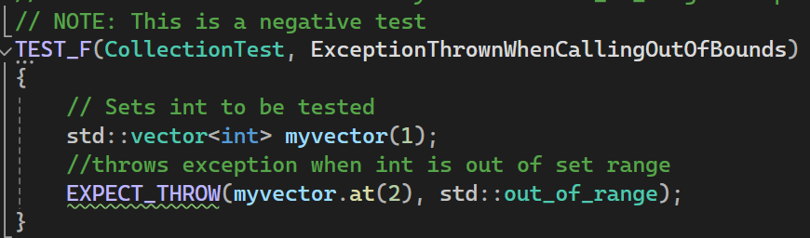
Unit Testing #4
This is a test to check that an exception is thrown when calling out of bounds information
This is what is called a negative test which make sure the program throws the right exception when there is an error
This is just as important as positive tests as it verifies the program's ability to output the right information

Slide 12

AUTOMATION SUMMARY
Automation is an important part in testing and ensuring thorough testing is completed.
Proper enforcement of automation can make development quicker and ensure all possible vulnerabilities have been tested and fixed.
The chart to the right shows the cycle of automation in software and key aspects to each step

Slide 13
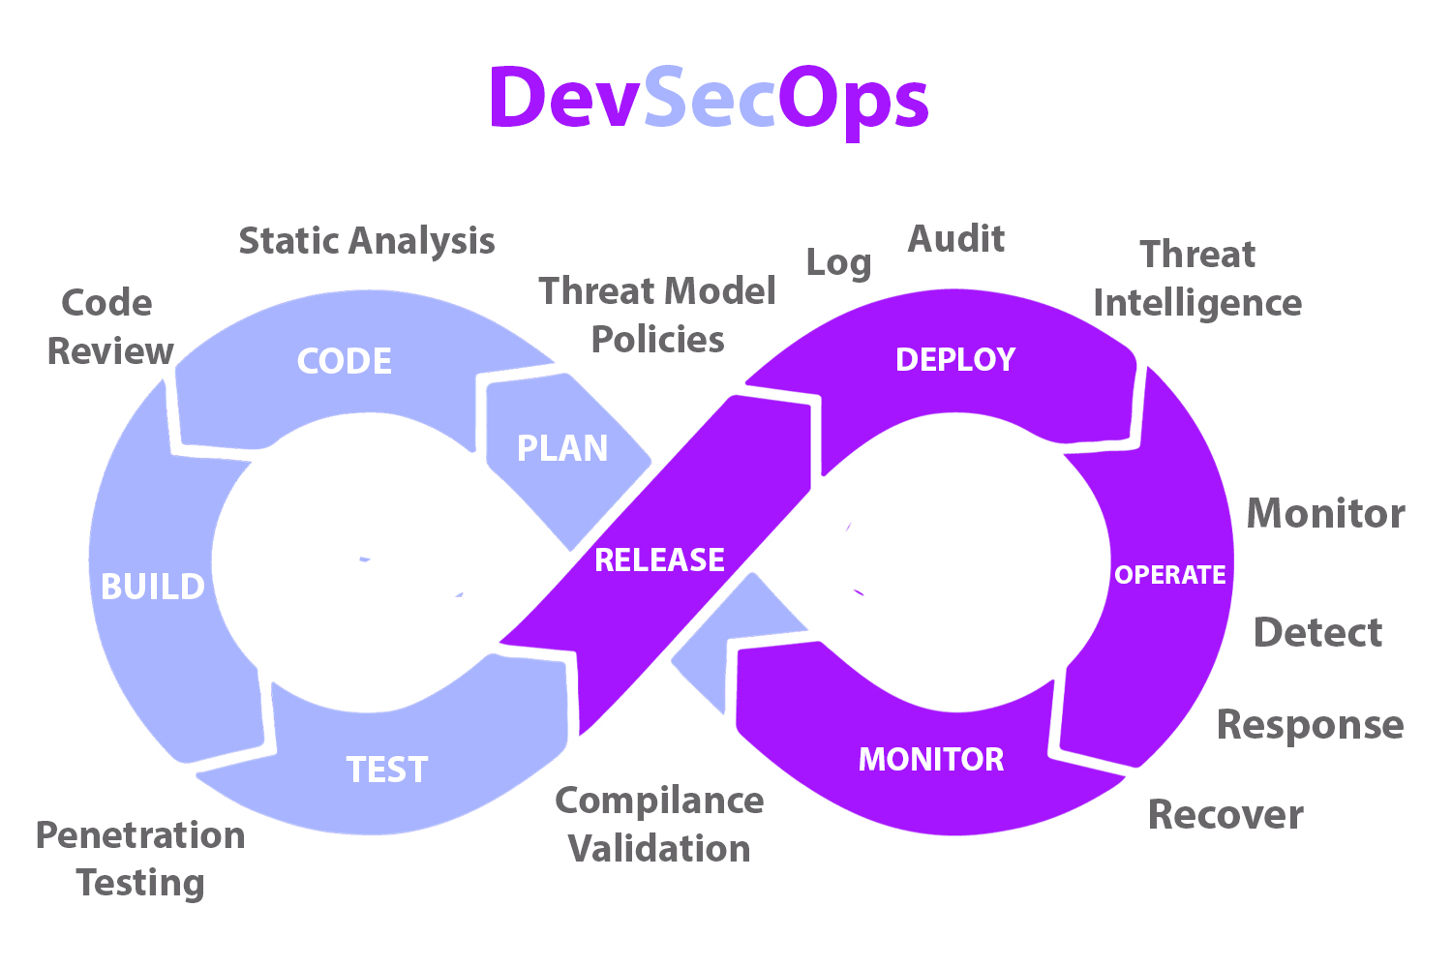
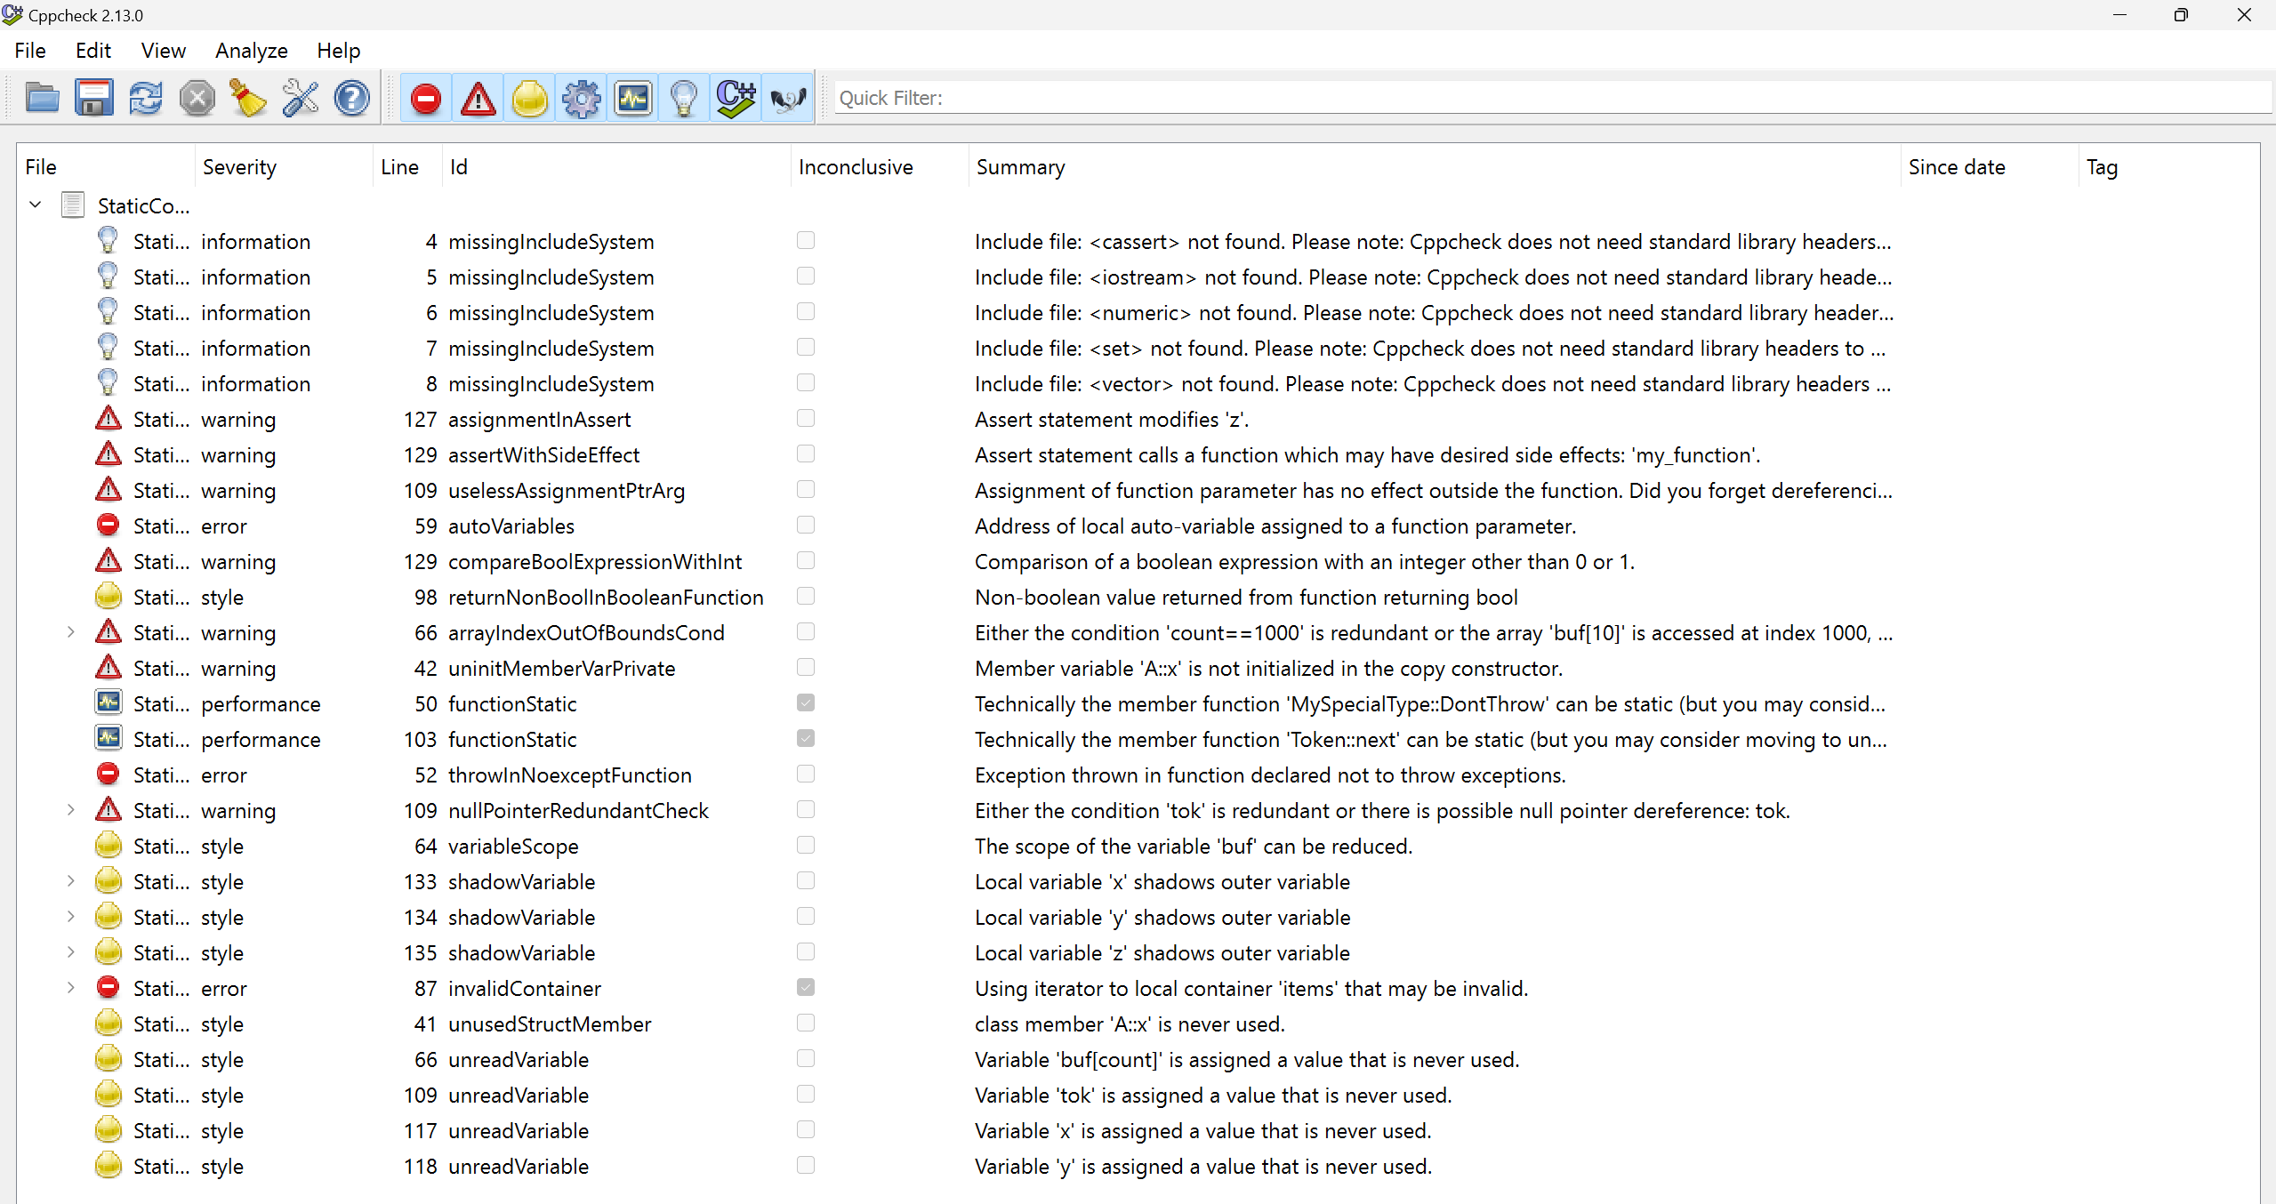
TOOLS
There are many tools to use, one of those being CPP checker, where an example is shown below
CPP checker would be sued in the code review/static analysis part of the DevSecOps pipeline
Some other tools that are available include Trivy, Instruder, GitLab SAST templates, and many more providing different areas of testing and tools to help developers create secure and efficient software.
DevSecOps is built onto the DevOps pipeline which builds security procedures into every step of the DevOps pipelines
There are many benefits of using DevSecOps which include reduced costs, higher software security protection, faster development, better testing options, and easier monitoring and logging
All developers should be using this pipeline to increase productivity and security of there software products

Slide 14
RISKS AND BENEFITS
Act Now –
Cons: increased upfront cost to implement new security features; increased time to teach developers how to implement and use the security features and testing; may need to upgrade hardware such as servers and computer to keep up with new software.
Pros: reduced risks; more knowledgeable and advanced software developers; reduced cost from potential of real attacks; new implementation of automation can reduce testing times and increase efficiency.
Wait –
Cons: risk of stolen user and company information which can cost a great amount of money to recover from; extra time to test.
Pros: lower hardware cost as old equipment will work; lower costs for less experience developers.
Examples: of companies who lost money from data breach fines, penalties, and settlements
Amazon Lost 877 Million
Equifax lost 575 Million
Instagram lost 403 Million
TikTok Lost 370 Million

Slide 15
RECOMMENDATIONS
After reviewing the analysis of the existing security policy these are the recommendations to reduce possible future issues.
Immediate implementation of DevSecOps
Immediate training of all software developers on new security standards
A complete review of all software and a list of more important to least important to secure
Implementation of automation into testing
Implementation of Triple A into everyday work
Regular reviews of current and future security vulnerabilities and threats.

Slide 16
CONCLUSIONS
With all the information presented it can show there are real life threats around us.
Those real threats can cost the company and users tons of time, money, and resources
This is why proper implementation of security standards such as DevSecOps, Triple A, and having a proper understanding of encryption policies can greatly reduce risk.
Although implementation of security standards may increase time and initial cost the pros far outweigh the cost
Immediate action is recommended and every second of waiting present opportunities for software vulnerabilities and attacks

Slide 17
REFERENCES
Froehlich, A. (2022, July 28). How to secure data at rest, in use and in motion. SearchSecurity. https://www.techtarget.com/searchsecurity/feature/Best-practices-to-secure-data-at-rest-in-use-and-in-motion
The biggest data breach fines, penalties, and settlements so far. (n.d.). CSO Online. https://www.csoonline.com/article/567531/the-biggest-data-breach-fines-penalties-and-settlements-so-far.html#:~:text=The%20biggest%20data%20breach%20fines%2C%20penalties%2C%20and%20settlements
What is AAA (Authentication, Authorization, and Accounting)? (2020, April 29). GeeksforGeeks. https://www.geeksforgeeks.org/what-is-aaa-authentication-authorization-and-accounting/
What is Defense in Depth? Defined and Explained. (n.d.). Fortinet. https://www.fortinet.com/resources/cyberglossary/defense-in-depth#:~:text=Defense%20in%20depth%20is%20a%20strategy%20that%20leverages

